Slide 1
WELCOME
30th Annual
Convention & Trade Show
#NARPM2018

Slide 2
THE 2018 STATE OF THE PROPERTY MANAGEMENT INDUSTRY:
Rediscovering the Human Element in Your Business
Chris Litster, CEO
Buildium
Gail Phillips, CEO
NARPM
Notes:
CHRIS INTRODUCE HIMSELF
GAIL INTRODUCE HERSELF
CHRIS:
As has become an annual tradition, we are so pleased to be sharing this annual industry report with all of you - FIRST.

Slide 3
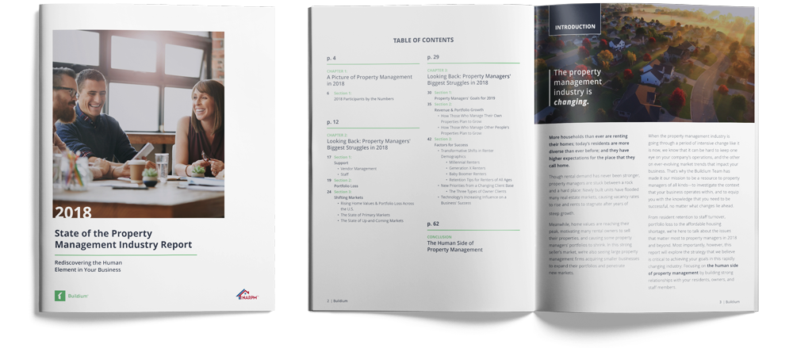
The State of the Industry
2018 NARPM/Buildium STATE OF THE PROPERTY MANAGEMENT INDUSTRY REPORT
Notes:
GAIL: This is now our 4th annual industry survey - our third in partnership between NARPM and Buildium - and what we want to say is that, while we’re seeing some fluctuations, this is an industry that is still proving to be full of opportunity. This being a complex industry, we looked at key factors like goals, growth, and priority and so on. And that’s good news.
CHRIS: Exactly. This year we dug into a number of different areas to pull out the most critical insights to share with you today. There is a LOT of data in here - and I could stand up here and recite the stats to you, which are interesting, but if you want to dig into those I invite you to swing by Buildium’s booth for a copy of the full report. This year we included a lot more open-field questions in our survey, so that we could not only capture quantitative data, but also qualitative.
And what we want to talk about today is the story that emerged from the hard data as well as the words from our respondents.
GAIL: That’s right, Chris. The story that came out was not the one we thought we would get. But it’s unmistakable - there is an emerging focus on the HUMAN FACTOR of property management that we heard loud and clear.

Slide 4
Today’s Topics
2019 Priorities and Concerns
Demographics
The Human Factor
2019 and Beyond
Notes:
CHRIS: Today, we’ll dig into what we learned from you – your Priorities and concerns for 2019, the demographics of our survey respondents, a closer look at ”the human factor” that came through, and also a look ahead into the future.

Slide 5
Today’s Topics
2019 Priorities and Concerns
Demographics
The Human Factor
2019 and Beyond
Notes:
CHRIS: Let’s start out with what’s on your minds as we look ahead to 2019

Slide 6
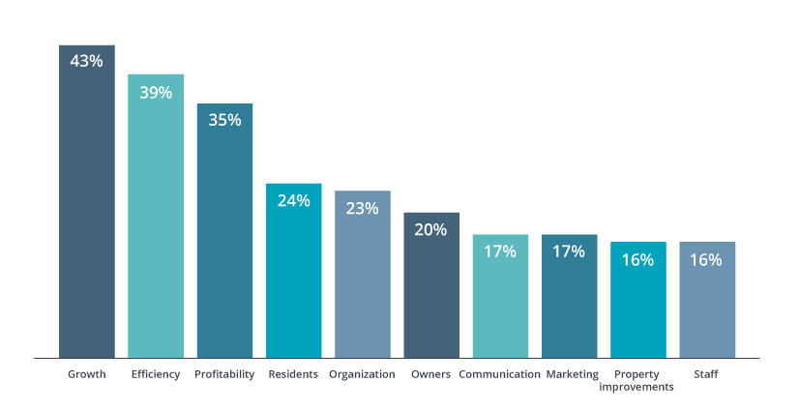
2019 Priorities
Notes:
GAIL: This is a question we ask every year. And, year over year, we always see the top 3 goals emerge - Growth, Efficiency, and Profitability.
Growing the portfolio and increasing revenue has moved back up to the #1 place this year – it had slid to #2 in 2017.
CHRIS:
Growth took the #1 place from last year’s #1 which was efficiency. This year, efficiency is #2.
- Notable jump of 9 points for profitability into 3rd place this year.

Slide 7
2019 Concerns
Market pressures and portfolio loss
Changes in property owner portfolio composition and strategy
Shifts in renter demographics
Evolutions in technology
Notes:
CHRIS: So, what is actually changing in the market?
2017 and 2018 ended up being a big seller’s market. But that’s slowing - Wall Street Journal and others are seeing slowing home price growth for several months in a row, which tells us we’re potentially at the peak in the market
This has an impact on the owners whose properties you manage - many property owners are opting to sell rather than stay in the rental game - and understanding the differences in your clients based on their goals is critical.
GAIL:
There have been seismic shifts in renter demographics over the last several years.
CHRIS:
Millennials, am I right?
GAIL:
Yes - Millennials are breaking the mold in so many ways, but one of them is in how they’re renting longer than previous generations. On the other side, Baby boomers are one of the fastest growing segments of the renter market as well. And that creates a challenge for property managers.
Last, the technology evolution marches on. Offering you new opportunities to connect with and create a great living environment for your tenants.

Slide 8
The Human Factor
What it means to focus your business on
the human factors:
1
Empathy- driven
2
Service- oriented
3
Tech enabled
Notes:
GAIL: If you take nothing else away from today’s session, it’s that these three factors that are impacting your business -- empathy, service, and tech -- are a powerful combination that will position you for success in the years to come.
CHRIS:
You may already be offering these
If you’re not, we’ll explain how by using the examples and statements from those of you who took the survey

Slide 9
Today’s Topics
2019 Priorities and Concerns
Demographics
The Human Factor
2019 and Beyond
Notes:
GAIL: For just a minute, we wanted to talk through the makeup of the property managers who participated in this survey

Slide 10
By the Numbers
1,857
U.S.-based Property Managers
Notes:
GAIL:
As we do every year, Buildium and NARPM gathered data from U.S.-based property managers, and in 2018 we had 1,857 respondents (almost a 40% increase over last year’s participation).
The data that follows has remained fairly consistent each year - we’ll call out anything that we saw move in this year’s survey, but here’s a quick snapshot of who you are:

Slide 11
Demographics:
Property Types
Notes:
GAIL: Most respondents are managing mixed portfolios - of this group, 77% manage single family rentals, 65% manage multi family rentals, 31% manage condos or community associations

Slide 12
Demographics:
Property Mix
Notes:
GAIL: 71% manage other people’s properties, 56% are owner-operators, and 15% are managing community associations

Slide 13
Demographics:
How Many Doors?
Notes:
GAIL: 50% manage fewer than 100 units, 35% manage between 101-500 units, with 15% managing more than 500 units
We know that NARPM members manage 100-500 units, so we know this aligns with our own membership data.

Slide 14
Demographics:
Revenue
Notes:
GAIL:
And, from a revenue perspective, you reported quite a range. More than half of you reported revenues under $250k/year, 13% make more than $1M
We noticed a slight lift in 2018 over 2017 – last year 59% reported under $250k/year while this year 52% fit that category, with more growth in the $750-1M category, up from 5% to 8% this year.
In summary, we were happy to see that your revenue is growing! You’re making more money!
**DON’T READ, FOR NOTES ONLY**
2017:
<100: 32%
100-249: 27%
250-499: 16%
500-749: 9%
750-1M: 5%
1M+: 11%

Slide 15
Demographics:
Tenure in the industry
Notes:
CHRIS:
Can’t say this definitively yet, but we think we’re starting to see something in the data that hints at a trend we want to dig into, which is about the future of the industry as a career. We see a decrease in the number of property managers entering the field in the last few years (21% 2017 and 14% 2018), as well as an increase in the 20+ year group (19% in 2017 to 22% in 2018), indicating that we may be seeing a growing segment of property managers who are approaching retirement from the industry, without an equal number of property managers entering it.
What could this mean for those of you still in the middle of your career? This is a question we will definitely be asking over the course of 2019 and we will continue to present this in next year’s session. It’s something we look forward to digging into this year
2017:
0-2: 21%
3-10: 40%
11-20: 20%
20+: 19%

Slide 16
Demographics:
NARPM Membership
Notes:
CHRIS:
What this chart tells me is that there is a fantastic recruitment opportunity for NARPM!
It’s important to note that this is not reflective of how many people in the industry are NARPM members, rather it’s solely the number of people who responded to the survey who are members vs. non-members.
However, there is a clear opportunity to communicate the benefits of belonging to NARPM. From the respondents, we heard that the connection, education, and value you get from your association with NARPM is invaluable:

Slide 17
NARPM Commentary
"It has made me a better property manager by connecting me with others in the industry to bounce ideas off of. Becoming more involved in NARPM has helped me to further my education and gain more confidence in myself and the value that I bring to my clients."
"I joined NARPM about 10 years ago, assuming I knew already everything in my business. I quickly learned dozens of ways to either improve or mitigate risk to my business, making me more profitable."
"It's a game-changer to have ongoing access to others in our industry; to share processes, technologies, and day-to-day experiences, as well as support during the challenging times."
Notes:
GAIL: Here are some quotes from our survey respondents!
It’s quotes like these that make my day. "I joined NARPM about 10 years ago, assuming I knew already everything in my business. I quickly learned dozens of ways to either improve or mitigate risk to my business, making me more profitable."
These commentaries reinforce why NARPM’s mission and dedication to residential property management industry is so important and valued - and maybe most importantly WANTED by our market. Thank you.

Slide 18
Today’s Topics
2019 Priorities and Concerns
Demographics
The Human Factor
2019 and Beyond
Notes:
CHRIS: Ok, Now we’re going to switch gears and dig into what we mean by “the human factor” and, more importantly, how to make sense of it all.

Slide 19
Serving the Human Factor
1
Empathy-driven
2
Service-oriented
3
Tech enabled
Notes:
CHRIS:
As we said, the themes that emerged were about approaching your owners and tenants with an empathy mindset, having a service-oriented - ALMOST CONCIERGE-like service mentality, and stitching it all together with technology that knits those relationships and those experiences into a seamless experience.
Let’s start with being EMPATHY-DRIVEN:

Slide 20
1
Empathy-driven
"The number one improvement that I have made within the company is building a relationship with the residents. I strongly believe that the property needs to feel like a home and a safe community, rather than just 4 walls and a payment due on the first of every month."
Notes:
CHRIS:
Many of you told us about the emphasis you’re placing on the relationships you create with your tenants as being a way to differentiate yourselves and keep them longer.

Slide 21
1
Empathy-driven
This is a human business:
Understand the OWNERS
Understand the RENTERS
Notes:
GAIL: Why call out empathy?
Property management is a human-driven business.
The better you are able to understand the motivations, aspirations, and needs of the humans that you serve, the better you can tailor your businesses to serve those needs
We start with ‘empathy’ because it is critical to how you establish services that align with what we understand about your clients and customers
The two main groups you work with are property owners and renters or potential renters

Slide 22
Empathy-Driven:
Understanding the Owners
PM strategies for success should mirror the goals and motivations of the property owner
Notes:
CHRIS:
So as part of understanding the owners, we looked at research we conducted earlier in the year. This Spring, Buildium talked to about 1200 property owners to gain insight about their goals and motivations. We found that they varied based on what type of property owner they were, what type of property they owned, and, the size of their portfolios. These elements shape the expectations of what kind of partner they’re looking for from a property manager. Here we’re just going to talk about what type of property owners showed up in the research:

Slide 23
Empathy-Driven:
Understanding the Owners
Accidental Landlords
In rental property ownership due to circumstance
Hire PMs for their expertise
74% want regular updates
32%
Intentional Investors
Purchased rental property as an investment
Hire PMs because it’s an investment, not a job
77% want regular updates
44%
Unintentional Investors
In rental property ownership due to circumstance, then decided to invest in more
Hire PMs for their expertise
87% want regular updates
23%
Notes:
GAIL:
We all know and love, the Accidental landlords. They make up 32% of the property owner market based on the data. These are folks who fell into becoming a landlord due to circumstances such as inheriting a house. In many cases these people aren’t in the same geographic region as the property they own, so their goals and motivations are going to focus much more on peace of mind and good communication than anything else.
CHRIS:
Then there are our investors - and what was interesting was that this year we saw two different types. Intentional investors made up 44% of the market and they’re looking for high value, high profit situations. These investors hire a property manager because the property is an investment – not a job. These folks want good communication, with 31% of them saying they want communication in real time, or on demand.
And then there was our surprise group, who we dubbed “unintentional investors” - at 23% of the market we couldn’t ignore them, and they were comprised of accidental landlords who, enjoying the stream of rental income from the first property, are starting to be a little more deliberate about how they optimize that income, whether it’s increasing profitability from that one property or exploring the purchase of others.

Slide 24
Empathy-Driven:
Understanding the Renters
Different generations of renters have different priorities and needs… most of the time.
Notes:
CHRIS:
The second half of the empathy equation is, of course, your renters. And, as we assessed the different needs of the different generations, we found, of course, differences… but not all of the time.

Slide 25
Millennials
Digitally fluent, 70% reporting that they prefer to conduct transactions and communications online or via mobile
Academic debt delays homebuying - the average student loan debt is $37k
Seller’s market means high home prices
Notes:
CHRIS
The 3 main groups of renters are Millennials, Gen X’ers, and Baby Boomers.
A quick note – we did look for information from “the silent generation” as well as Gen Z, but we didn’t have a strong enough sample size to include them. GenZ, the generation who just graduated or are graduating over the next several years, are going to be an interesting addition to this mix as their numbers grow in the renter market
GAIL:
Millennials are digitally fluent, meaning that they have grown up with readily accessible internet, social media, and mobile phones. More than 70% reporting that they prefer to conduct transactions and communications online or via mobile
Academic debt delays homebuying - the average student loan debt is $37k and wage growth is not increasing as fast as rent growth
Seller’s market means high home prices
SHARE BEN’S STORY

Slide 26
Gen X
Some are only just recovering from the credit hit from the Great Recession
Digitally fluent but also look for rentals using offline methods
1/3 of rental households are Gen X
Notes:
CHRIS:
Gen X - it’s easy to lose track of GenX renters because there is so much activity happening at the extremes - on the one hand there are millennials! On the other hand, there are Baby Boomers! But fully ⅓ of rental households are led by GenXers.
Some of these folks who were hit hard by the last recession are only just finally fully recovering.
GenXers are also “digitally fluent” - but they remember when the phone rang in the kitchen and was attached to the wall, but have readily adapted to our application economy and tend to prefer digital communications and transactions, but they may also utilize print or other offline methods

Slide 27
Baby Boomers
Fastest-growing renter segment - currently ~21% of renter households
Require a broader range of services as they age
Digitally familiar; 2/3 want to handle rental processes online, more than half show preference for smart home tech.
Notes:
GAIL:
Baby boomers are the fastest growing renter segment - 21% of renter households. Put differently, they currently comprise 10m of the 44m renter households in the US.
These folks are opting to rent in retirement, likely as a way to decrease the maintenance responsibilities of an owned home. Many of them are retiring to more urban areas, while still others are moving closer to ‘the kids’. They also want to be able to travel!
Unlike Millennials, Baby Boomers are looking for a fairly permanent rental arrangement, and will benefit from a broader range of services and amenities as they age - think, grab bars in the showers, the option for ramps over stairs, single-level living etc.
Baby boomers are “digitally familiar” - in that the internet is a major part of their lives, but they’re not glued to their phones. Interestingly, Baby Boomers do show preference for properties offering smart home technology

Slide 28
Not so different...
87% of Millennials and…
60% of Baby Boomers prefer online rental processes
71% of Millennials and…
55% of Baby Boomers are interested in smart home tech
Notes:
CHRIS:
While it’s easy to generalize, and look at Millennials and Baby Boomers as being opposite sides of the spectrum, in reality, when it comes to technology, they’re not as far apart as you might think.
87% of Millennials and 60% of Baby boomers prefer online rental processes
71% of Millennials and 55% of baby boomers indicated interest or preference in smart home tech

Slide 29
1
Empathy-driven
Owners: understanding who your clients are and what they need helps inform the services you offer your clients
Renters: navigating the differences - and similarities - in your renters helps inform the services and amenities you offer your tenants
Notes:
CHRIS:
So, just to recap. Offering empathy-driven service to both the owners and the renters you work with is the first piece of the puzzle – by understanding the individual needs of your clients and attending to the expectations and behaviors of your renters, you will be better able to establish strong and positive relationships.

Slide 30
2
Service-oriented
"Never make your business a 'business'—it's a home for the resident and a retirement account for the owner. Keeping it personal makes all the difference."
Notes:
GAIL:
The second part of harnessing the human factor is how to take that understanding of your owners and their goals and needs, as well as your renters with their requirements and preferences, and turn that into a viable business model.
A respondent told us, Customer service is often the number one complaint in housing. Staying up-to-date with residents and active communication will result in higher retention and a better sense of community overall.”

Slide 31
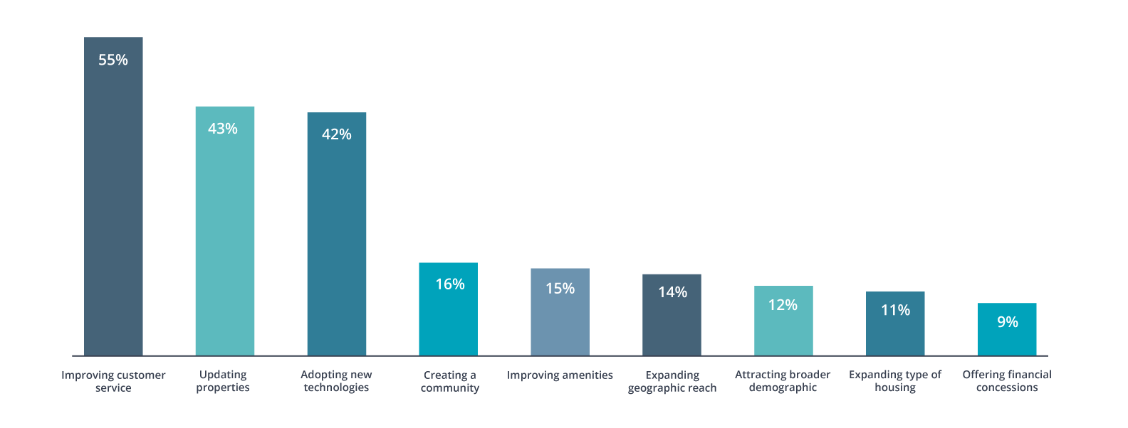
Service-Oriented
Shifting strategies
Notes:
GAIL:
A one-size-fits-all approach to customer service will become increasingly ineffective—and the importance of personalizing your offerings and understanding the demographics you serve will only grow in the years to come.
By a wide margin, “improving customer service” was the lead answer when we asked about how property managers were shifting their strategies to align with their target renter demographics.

Slide 32
Service-Oriented
Primary services for owners
Notes:
CHRIS:
When it comes to the kinds of services you reported providing for owners, 60% offer the same 10 services. We consider these to be Table stakes—they were the same last year and this year…
A note on this – we spent a fair bit of time on this last year, encouraging property managers to consider this list of table stakes and then differentiate themselves with some of the less common services – this year’s Top 10 is the same as in 2017, so if you took us at our word, you’re still on track.

Slide 33
Service-Oriented
Focus areas for growth
Adding revenue-generating amenities
Bringing maintenance and other services in-house to lower costs
Freeing up time to focus on revenue-generating activities by leveraging technology
Improving customer service to retain residents and save turnover costs
Negotiating better contracts with vendors to lower expenses
Raising under-market-value rents
Notes:
GAIL:
And lastly, here are the top areas you told us were part of your strategic plan to grow, whether you manage your own properties or manage on behalf of a property owner. Note that only #4 is specifically focused on the human factor, although #1 speaks to understanding the needs and preferences of your renters.
[LET THEM READ FOR A MOMENT, THEN CLICK TO NEXT SLIDE]

Slide 34
2
Service-Oriented
Align what you understand about your owners with the services - and value - you provide
Focus on the most sought-after amenities and services for the renter demographics you serve
Notes:
GAIL:
So, to recap this second section – based on what you understand about your two primary audiences, ALIGN what you know about the kinds of owners you work with, with the services and value you provide to them. And also enhance your service by FOCUSING on the most sought-after amenities and services for the renter market you serve.

Slide 35
3
Tech-enabled
“The more technology we have invested in, the better the tenant experience has been, reducing customer strife and increasing employee efficiency.”
Notes:
CHRIS:
The third piece of the puzzle is around technology enablement. Why are we talking about tech-enabled relationships instead of just technology? It’s because technology’s job is to streamline and improve offline interactions by taking them online, in most cases. The world is flooded with new technology options every day, and “technology for technology’s sake” will just drive you crazy.
The best way to keep your feet under you with respect to technology is to consider how the technology you’re selecting helps you to take the EMPATHY-driven understanding of your owners and tenants, as well as the SERVICES you offer as a result, and streamline it using technology.

Slide 36
Tech-enabled relationships
Owners, Renters and Technology
Did you know?
77% of owners want an owner portal
61% of renters want to pay rent online
62% of renters prefer to email; 55% prefer communicating by text
Notes:
CHRIS:
When we surveyed owners and renters earlier in 2018, the appetite for tech-enabled communication and transactions was clearly high
The data bears this out:
77% of owners want an owner portal
61% of renters want to pay rent online
62% of renters prefer to email and 55% prefer to text

Slide 37
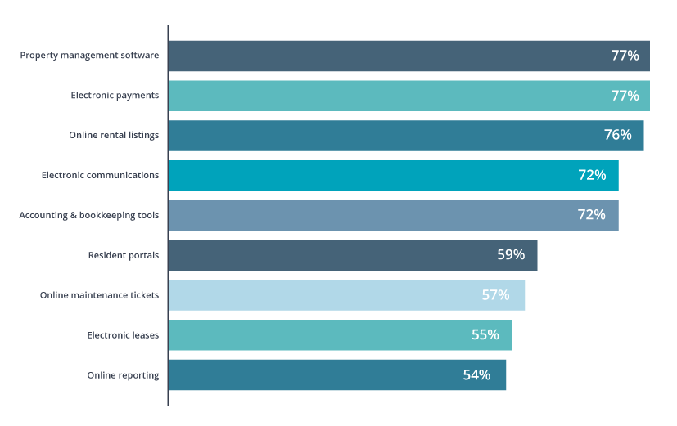
Tech-enabled relationships
Property Managers and Technology
Notes:
CHRIS: In fact, in 2018, these technologies have made the transition from a competitive differentiator to a must-have. Harnessing the power of online interaction is quickly becoming the norm.

Slide 38
Tech-enabled relationships
Property Managers and Technology
“The automation of property management is the best thing that has happened to our office. We have moved from paper to the computer, and being able to see everything in front of you immediately allows you to make immediate, important decisions."
Notes:
CHRIS:
One of our respondents said, “The automation of property management is the best thing that has happened to our office. We have moved from paper to the computer, and being able to see everything in front of you allows you to make immediate, important decisions.”
Remember, the best technologies don’t just increase your efficiency - they have the power to enhance the human side of your property management business

Slide 39
Business Impact of Software
83% of those who expect to significantly expand their portfolio in the next two years use property management software
83% of those who use property management software report that their revenue has increased over the last two years
More than 8 in 10 property managers
use property management software
regardless of whether their top goal is growth or efficiency
Notes:
GAIL: I’m going to speak to this one so you all don’t think it’s Chris being biased in any way. One of the things we know about all of you is that you are focused on continuing to grow which is why you are here. As we discussed last year, growth and efficiency go hand-in-hand, and so what we saw this year is that growth-focused property managers are still more likely to invest in software to help them scale their operations. This frees up time for them to focus on continuing to grow their businesses and attend meetings to network with each other.
83% of respondents who said they expect to significantly grow in the next year also indicated that they had implemented a property management software solution. And 83% of people who had previously implemented a solution reported an increase in revenue over the last two years.
Sentiment in the feedback cites the ability to automate and streamline fees and charges, as well as creating time to grow revenue opportunities across their business. Start searching for that tech service that makes you stand out and also increases your revenues!

Slide 40
Tech-enabled relationships
Technology should enhance and improve the services you provide
Make technology purchase decisions based on human experience - and scale
Invest where it will make the most difference to your business goals
Notes:
CHRIS:
So what did we just talk about – tech should enhance, improve, and differentiate the services you provide, but you should never chase tech for tech’s sake. Make your decisions based on the human experience you’re looking to create – and then scale. And technology should always be a strategic decision – consider what your business goals are and map your purchase decisions from there.

Slide 41
Today’s Topics
2019 Priorities and Concerns
Demographics
The Human Factor
2019 and Beyond
Notes:
GAIL:
Our last section looks into the future, and from our vantage point, doing this research each year, 2019 and 2020 are poised to be big years for property managers

Slide 42
2019 and beyond: the human factor in property management
1
Focus on empathizing with the needs of your property owners and residents
2
Map your service offerings to that understanding of that relationship
3
Connect those relationships and services with technology that elevates and improves both
Notes:
CHRIS:
First off, take the time to assess how you are incorporating what we’ve discussed here today into your own business model. How does the human factor impact your property management business?
First, focus on empathizing with the needs of your property owners and residents
Then, map your service offerings to reflect how you understand and account for those needs
And lastly, connect those relationships and services with technology that elevates and improves both

Slide 43
2019 and beyond: the opportunity
What we’re seeing:
1
Market shifts indicating changes to come
2
An ‘inflection point” moment presents opportunity to assess - are you an empathy-driven, service-oriented, tech-enabled business?
3
Growth ahead
Notes:
GAIL:
what does it mean for 2019 and beyond?
We are seeing the market starting to change - in the next 2 or so years, the pendulum will swing from sellers market to buyer’s. There is a direct relationship between the current housing market, and what that means for renters. These market trends paired with this report data is telling us we’re looking at a great time for property managers to assess their business model along these lines. Why? To be best prepared to win when the market changes!
CHRIS:
That’s right. We’re at this inflection point moment of the market – by doing the legwork now, you’ll be poised to succeed as the market begins it inevitable change - can we pinpoint the year/month? No. But you’re at a point now where luck favors the prepared.

Slide 44
Get Your Copy!
Stop by the Buildium booth and get the full report
Notes:
CHRIS: To get the full report, be sure to stop by the Buildium booth for your own copy of the industry report, and we’ll see you next year!

Slide 45
Thank You
Notes:
GAIL: With that, we thank you for being here today as we discussed the findings from our annual survey!
A few personal thoughts as we close… With the market shifting, you will see more agents becoming Property Managers. Take the information supplied in this research and start now to find a service that makes you and your company stand out from the rest. Also remember to concentrate efforts on improving your customer service experience for the owners and tenants. Then you will stand out!
Thank you Chris and Buildium...

